Slide 1




Tactical Detection and Data Analytics Summit
Save the Date: December 4-11 Scottsdale, Arizona
sans.org/summit
SEC599 – Defeating Advanced Adversaries
SEC530 – Defensible Security Architecture
SEC555 – SIEM with Tactical Analytics
SEC511 – Continuous Monitoring & Security Operations
SIEM NetWars
SUMMIT
Dec. 4-5
TRAINING
Dec. 6-11
sans.org/summit
Notes:
Drag Picture and Send to Back

Slide 2
SEC555
Presentation based on SEC555: SIEM with Tactical Analytics
SIEMtervention
Magic unicorns are real?
Justin Henderson (GSE # 108)
@SecurityMapper

Slide 3
About Me
Author of SEC555: SIEM with Tactical Analytics
GIAC GSE # 108, Cyber Guardian Blue and Red
60 industry certifications (need to get a new hobby)
Two time NetWars Core tournament winner (offense)
And security hobbyist and community supporter
Collecting interns/contributors in bulk (research teams)
Release research to the community
See https://github.com/HASecuritySolutions

Slide 4
Welcome!
A copy of this talk is available at: https://github.com/HASecuritySolutions/presentations
More free stuff: https://github.com/HASecuritySolutions Disclaimer: This talk is NOT about bashing SIEM solutions or promoting one vendor/solution over others

Slide 5


Logs from all the Lands
In the beginning...
There were many logs, each of a different kind
Correlation between these logs was difficult, nay impossible
Each log represented a different concept and had different meaning
But then the magic unicorn came
And all became clear

Slide 6
Commercial Implementations
Commercial off the shelf (COTS) products provide:
Native agents and parsing
Support and maintenance
Ability to search disparate data sources and quickly
Automated alerting capabilities
With alert prioritization!
Machine learning and behavior analytics
Professional services and implementation

Slide 7

What Happened?
In the mist out comes not a unicorn, but a rhino???
How did we get it so wrong?
Commercial SIEM solutions all can be successful
Yet many fail and lead to health issues such as heartburn, diarrhea, death by boredom, or worst
Cause of failure is deviation from the core objective - detection

Slide 8
What Do You Have vs. What Would You Like?
80% time Care and feeding SIEM
80% time Detection
versus
20% time Detection
20% time Maintenance

Slide 9
Time for an Intervention
SIEM failure is often caused by the following:
Too many manual tasks
Inverse is lack of automation
Working for your SIEM instead of it working for you
Context is key to efficiency so let your SIEM add context
Focus on more/all logs rather than tactical logs
More is often not better
All of the above are people and process issues

Slide 10

Traditional vs Network Extraction
Traditional
Network Extraction
Multiple collection points
Single collection point
DNS logs
SMTP logs
HTTP logs
DNS logs
SMTP logs
HTTP logs
Log Aggregator
Log Aggregator
agent
agent or syslog
agent or syslog
agent
DNS Server
SMTP Server
Web Proxy
Network
Extraction Sensor

Slide 11
NXLog AutoConfig
Overcomes log agent deficiencies and is a functional proof of concept
https://github.com/SMAPPER/NXLog-AutoConfig
Checks systems each day looking for components (IIS, etc)
If found, automatically configures for consistency
Or initial configuration…
Then sets up agent to start shipping logs
Use case organization spent lots of time managing agents

Slide 12

Log Enrichment and Adding Context
Infrastructure Service Logs
Enrichment Techniques
DNS
HTTP
HTTPS
SMTP
Almost every network uses them
Lots of noise = lots of logs
Yet can be high value
Low value logs can morph into highly actionable detects
Baby Domains
Entropy Test (PH Imbalance)
Invalid Fields (wrong state)
Fuzzy Phishing

Slide 13
Ordinary to Extraordinary
query: www.google.com
query: www.google.com
subdomain: www
parent_domain: google
registered_domain: google.com
creation_date: 1997-09-15
tags: top-1m
geo.asn: Google Inc.
frequency_score: 18.2778256342
parent_domain_length: 6
Enriches to this

Slide 14
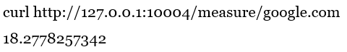
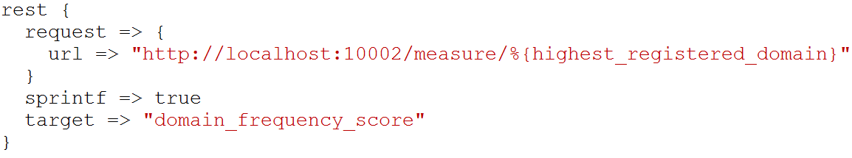
freq_server.py
freq_server.py is for large scale entropy tests
Created by Mark Baggett, author of SEC573
Manual testing
Logstash query

Slide 15
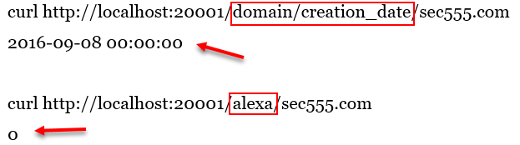
domain_stats.py
Mark Baggett developed domain_stats.py
Designed for speed and log analysis
Provides on mass domain analysis
Provides whois information like creation date
And top 1 million lookups (works with Alexa and Cisco)
Result
Result

Slide 16
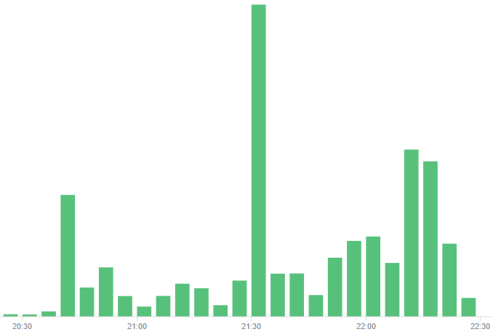
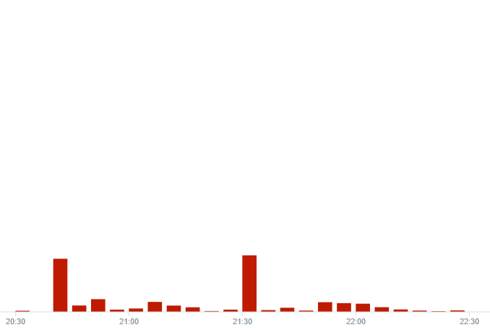
Top1M Filtering
Before
After - approx < 90% logs

Slide 17

Fuzzy Phishing
Many SIEM techniques use insider information
Such as fuzzy phishing searches
Take legitimate company domains and look for variants
Extremely effective against phishing domains
Best used in combination with email alerts or scripts
Great for targeted attacks

Slide 18
Endpoint Analytics
Endpoint logs are incredibly powerful yet underutilized
Too much emphasis on “insert security product here”
Not enough visibility on desktops/laptops
Endpoint logs can readily be operationalized
Strategies such as below can be used to detect attacks using
Long command lines
Unauthorized service creations
Malicious PowerShell use
Internal Pivoting
Brute force logins
Whitelist evasion

Slide 19
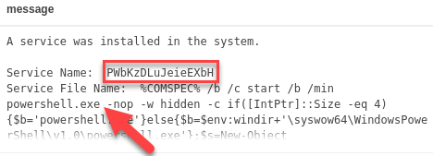
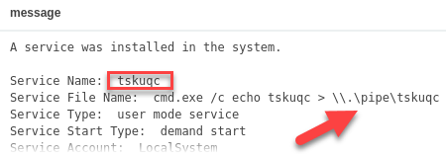
Service Creation Gone Bad (Event ID: 7045)
Common attack techniques create services
Top example is of Meterpreter compromise through PSExec
Bottom event is of privilege escalation

Slide 20
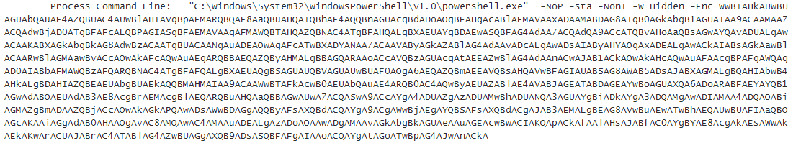
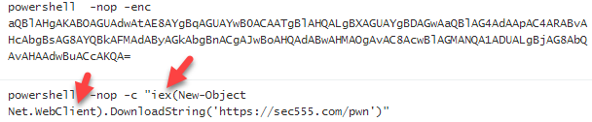
PowerShell Attacks (Event ID: 4104 or 4688)
PowerShell is now commonly used for modern attacks

Slide 21
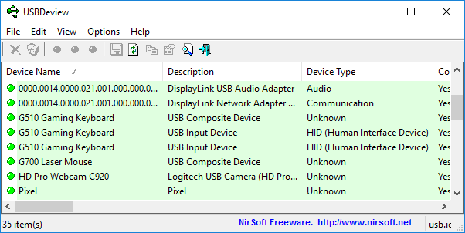
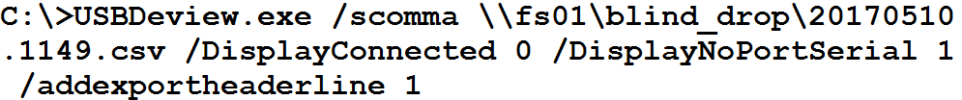
NirSoft USBDeview¹
Simplification is acceptable/preferred
Possible to run 3rd party tool once a day and log to file
Better late than never

Slide 22
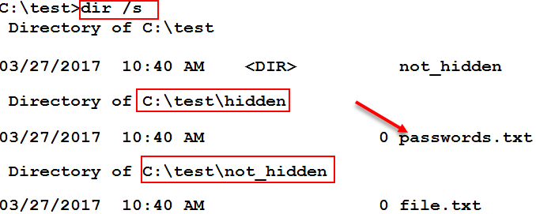
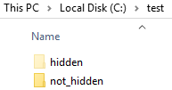
File Auditing (Event ID 4663)
Automated scripts/malware often used to find patterns
Social security #, credit card #, or drivers license
Operate by enumerating and reading through files
Often ignores hidden folders

Slide 23
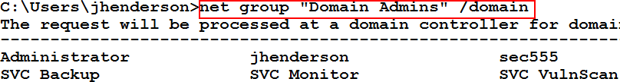
Group Querying (Event ID 4662 and 4663)
By default all users can list group members
Attackers enumerate members to find users to target
Many alternative methods to list group members
Mickey Perre has a blog on detecting this behavior
Windows auditing can capture read member requests
Combined with agent/aggregator filters = AWESOME

Slide 24
HALO (Honeytokens Against Leveraging OSINT)
Fake users can be created publicly to combat recon
Could be just in hidden metadata and/or key public sites
Example: Peter Parker(pparker@sec555.com)
On LinkedIn, Facebook, Adobe, PGP, Github, etc.
Likely to be picked up during OSINT
Eventually may make compromised account lists
Takes minimal time to setup… can get fairly elaborate
Activity from this account is malicious and provides context

Slide 25
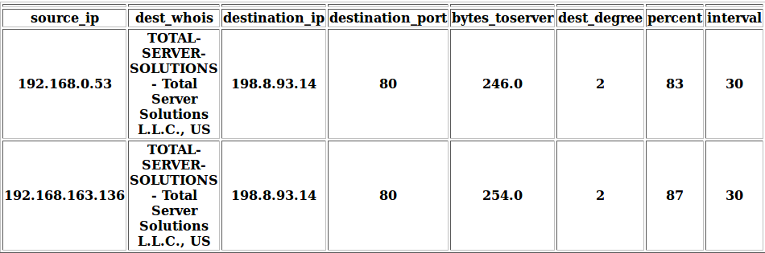

Flare
Austin Taylor wrote a beacon discovery script called Flare
Uses Elasticsearch to crawl historical connections
Identifies connections with consistent beaconing
Supports analysis of custom time periods
Additional capabilities being baked in

Slide 26

Summary
SIEM is just a tool (a really awesome one)
Yet tools are ineffective when not used properly
You need to:
Automate, automate, automate (80% / 20% rule)
Make your logs more context rich (log enrichment)
Analyze tactical logs (yes even on your workstations)
Consider SEC555: SIEM with Tactical Analytics
Focus is on training people and establishing processes

Slide 27
Tactical Detection and Data Analytics Summit
Save the Date: December 4-11 Scottsdale, Arizona
sans.org/summit
SEC599 – Defeating Advanced Adversaries
SEC530 – Defensible Security Architecture
SEC555 – SIEM with Tactical Analytics
SEC511 – Continuous Monitoring & Security Operations
SIEM NetWars
SUMMIT
Dec. 4-5
TRAINING
Dec. 6-11
sans.org/summit
Notes:
Drag Picture and Send to Back

